Slide 1
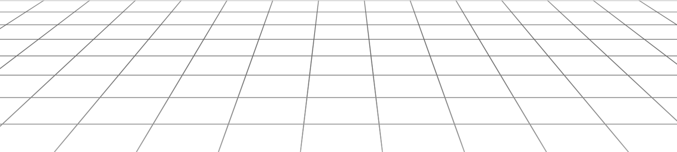



GAMESHARE
Rent, Play, Return - Unlock Endless Gaming!
Team 4

Slide 2




Our Team
Vandana Gandepalli
Ariyana Joseph
Rithindatta Gundu
Sai Vikshit Kode

Slide 3
Presentation Outline
Problem & Mission
Persona
Prototype Phases
Hi-Fidelity
Demo
Lessons Learned

Slide 4


Problem
The lack of affordable access and a streamlined rental platform for gaming equipment limits gamer’s ability to explore new games and hardware.
Our Mission
To create a user-friendly platform that allows gamers to rent and return gaming essentials flexibly, ensuring an accessible, affordable, and trustworthy experience for all.

Slide 5

PERSONAS

Slide 6
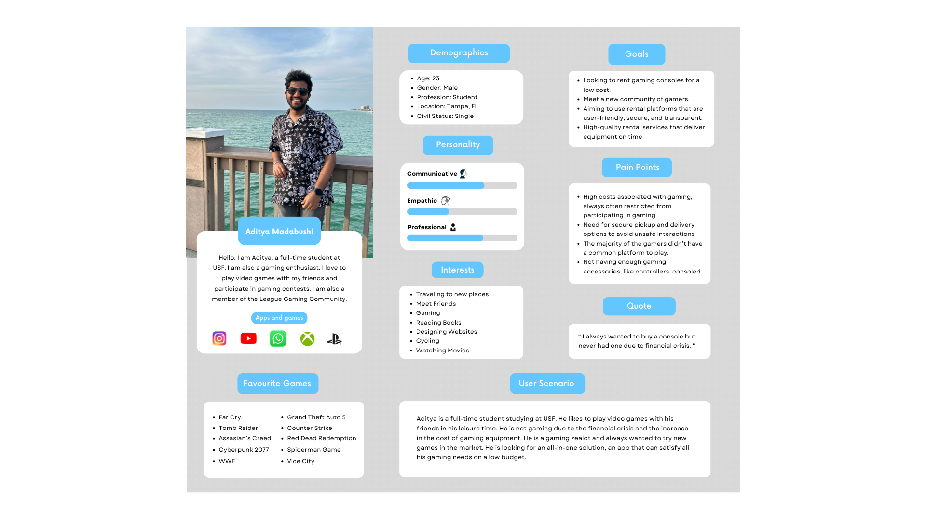
Primary Persona
Student

Slide 7


I always wanted to buy a console but never had one due to a financial crisis.
Aditya Madabushi

Slide 8
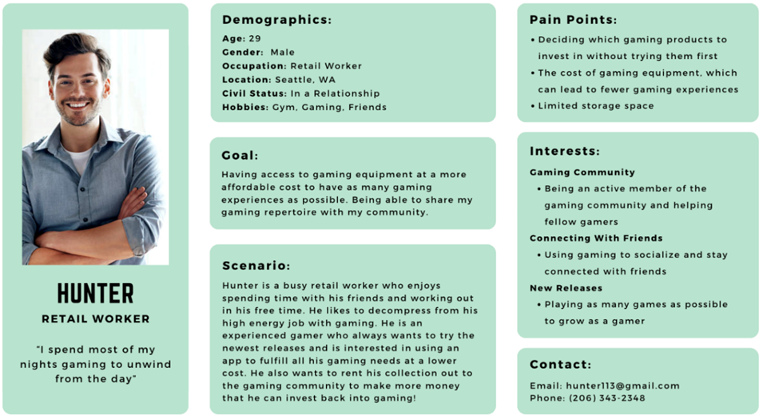
Secondary Persona
Retail worker

Slide 9

I spend most of my nights gaming to unwind from
the day.
Hunter

Slide 10

PROTOTYPE PHASES

Slide 11
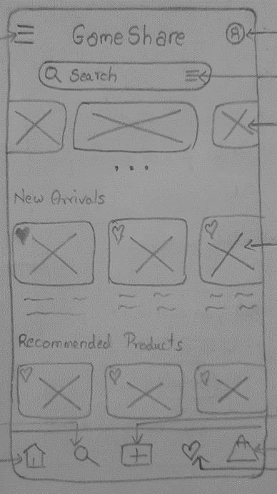
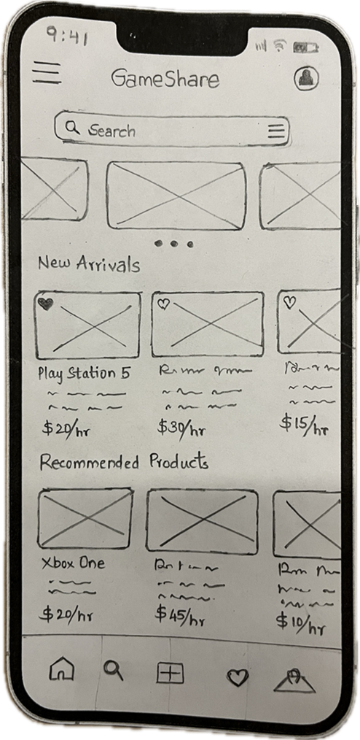
Sketch
Prototype
Home Page

Slide 12
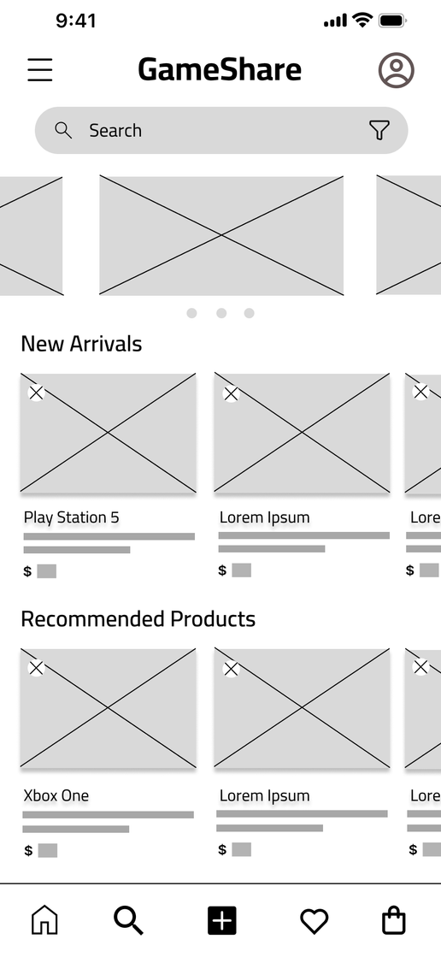
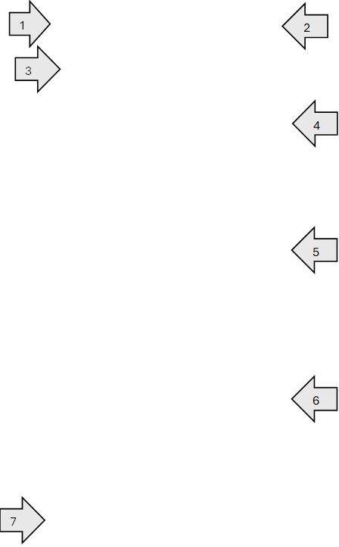
Home Page
1 | A button to open the side navigation bar
2 | A button that takes the user to their Profile page
3 | A search bar with a filter button
4 | A carousel with featured products that the user can scroll through
5 | New arrivals that the user can scroll through. Each item can be selected, and the user be taken to the product description page.
6 | Recommended products that the user can scroll through. Each item can be selected, and the user be taken to the product description page.
7 | The bottom navigation bar

Slide 13
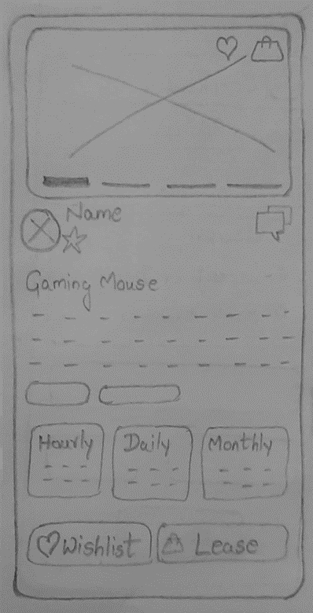
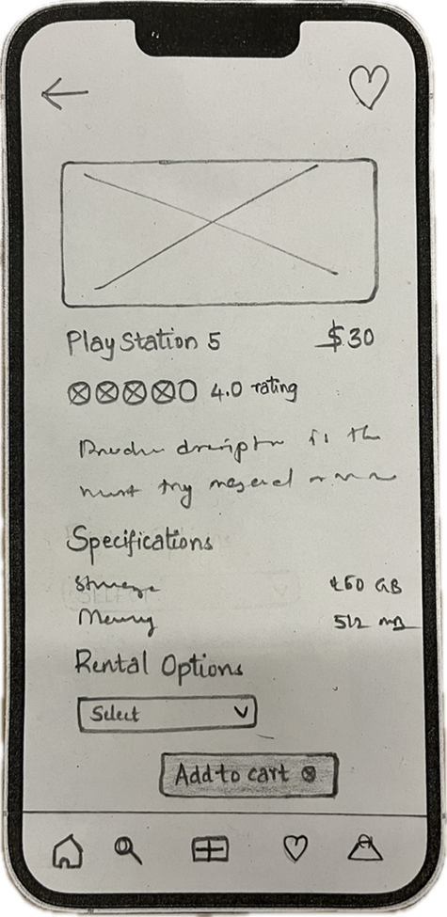
Sketch
Prototype
Product
Page

Slide 14
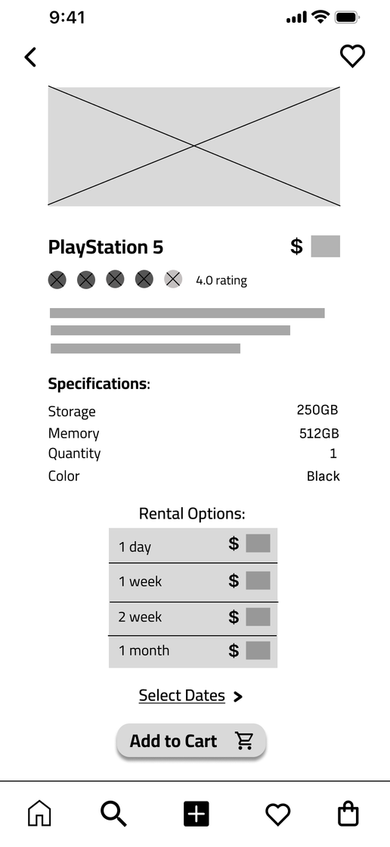
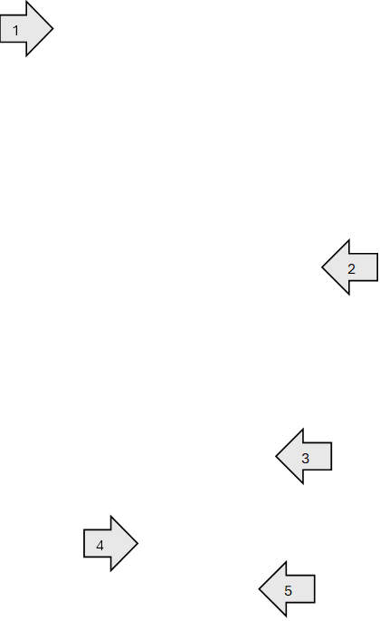
Product Page
1 | Button to return user to the previous page they were on
2 | Descriptors of the product displayed to the user, including title, description, price, rating, and specifications
3 | Pricing for different time frames displayed to the user
4 | Button that takes user to a date picker to select the rental period desired for this product
5 | Button that takes user to the Shopping Cart page

Slide 15
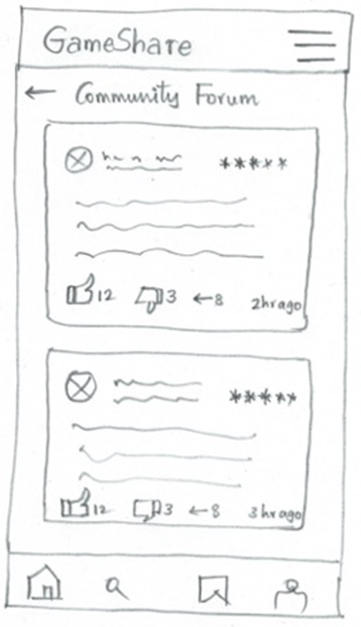
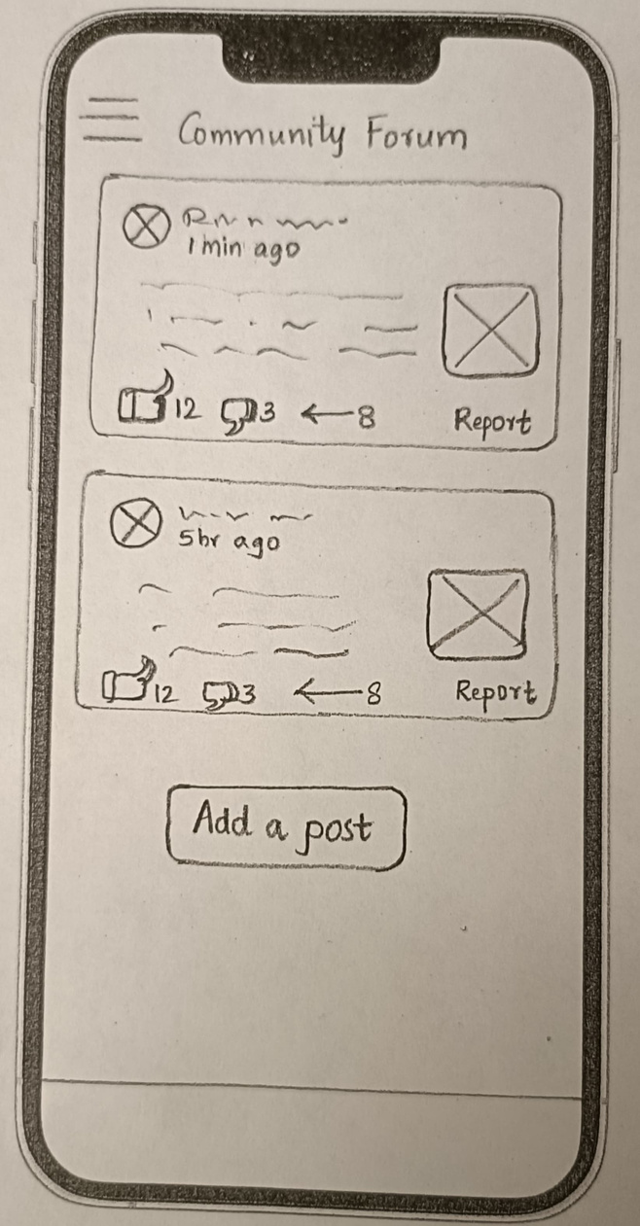
Sketch
Prototype
Community
Forum Page

Slide 16
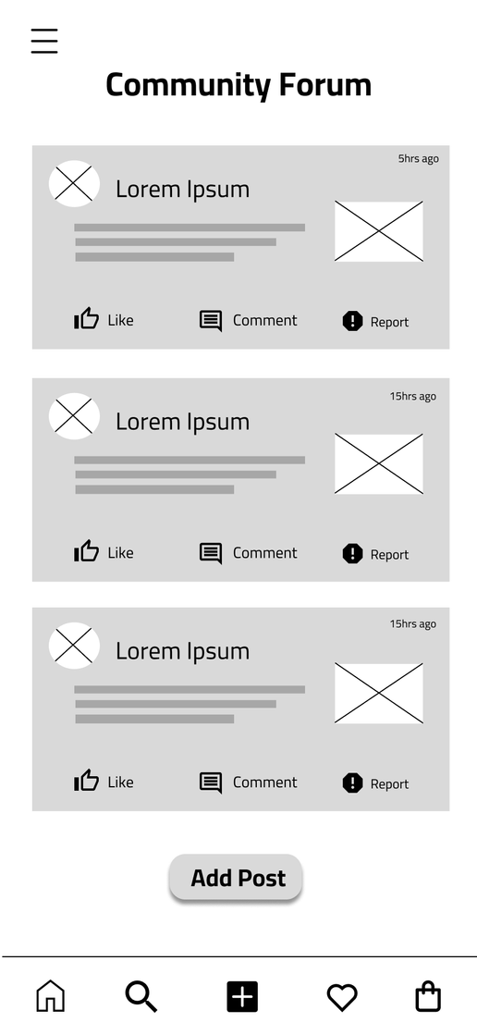
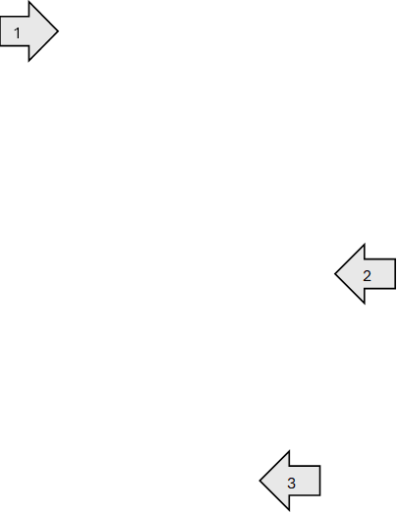
Community Forum Page
1 | Posts from users (earliest to latest) are displayed with their profile picture, header, body, picture and timestamp
2 | Like Button darkens when selected to indicate user has liked selected post Comment button takes user to the Add Comment page Report button takes user to the Report Post page
3 | Button that takes user to the Create Post page

Slide 17
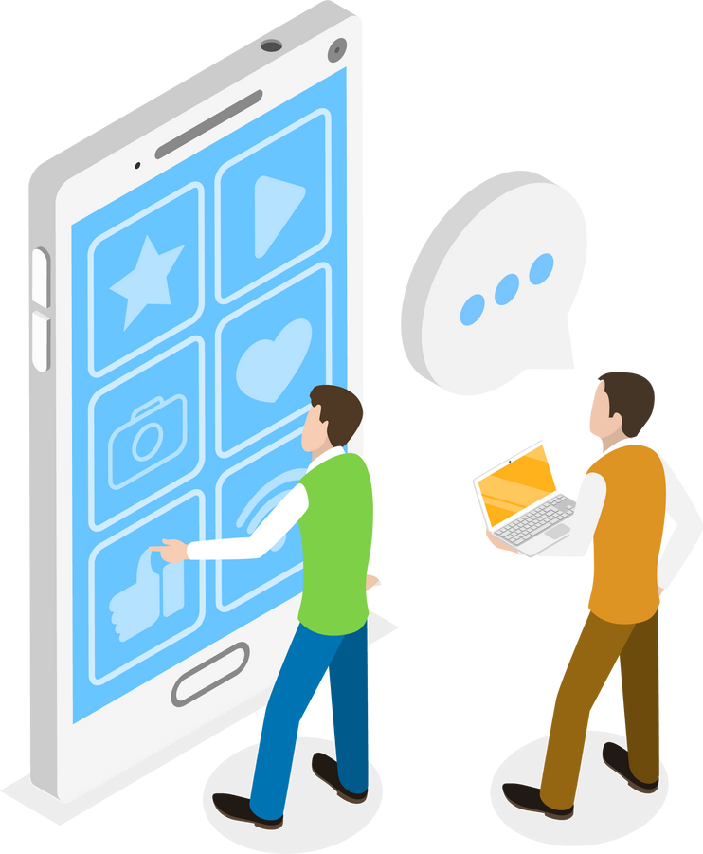
HI-FI PROTOTYPES

Slide 18

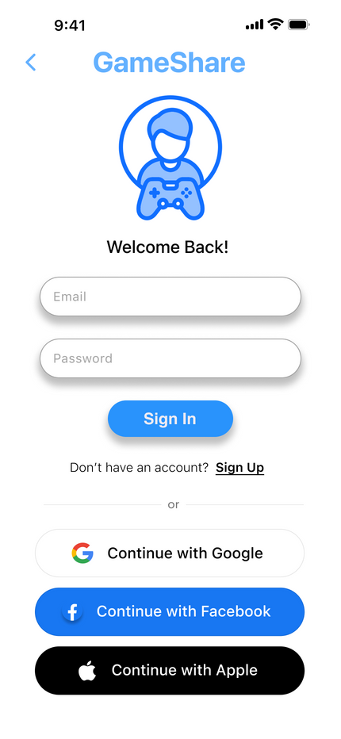
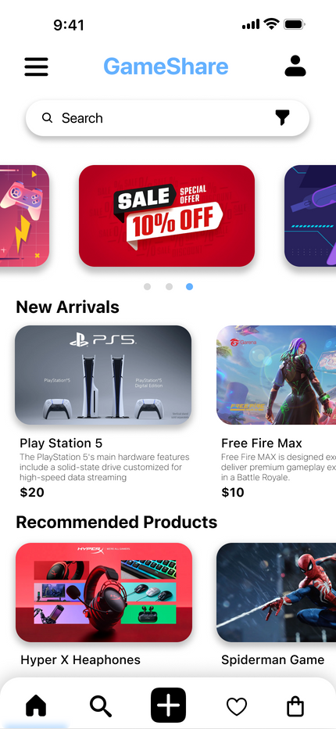
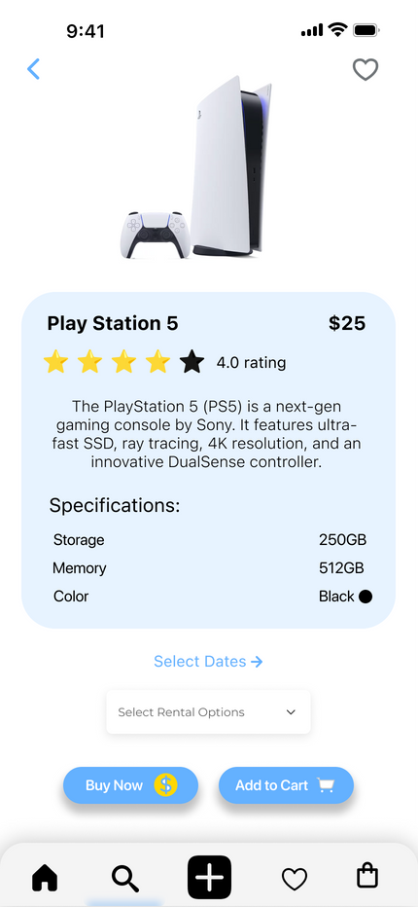
Design Elements
Colors:
Primary: Blue
Calm, Trust, Intelligence
Secondary: White
Simplicity, Minimalism
Font:
SF Pro - Light, Regular, Bold
Navigation:
Main Features - Botton navigation bar
Additional Features - Hamburger menu
Interactions:
Drop down menus, Checkboxes
Pop-ups
Buttons

Slide 19

LIVE DEMO!
Figma Link
3 User Flows:
1. Search for PS5 and rent it
2. List a product for rent
3. Add a post on the community forum

Slide 20

LESSONS LEARNED

Slide 21

Usability Testing
Highlight mandatory fields
Disable irrelevant fields
Make buttons and input fields more distinguishable
Affordance
Less is More
Reduce cognitive load
Simplify and prioritize
Choice Overload
Utilize both text and icons
Lablel navigation bar
Descriptions for input fields
Feedback
Labeling

Slide 22




Overall
Communication
Brainstorming
What has been done
What needs to be done
What can be done better
Individually and as a team
Generates new ideas
Faciliates problem solving
Time Managment
Dividing Workload
Stary early - as soon as possible
Make a plan and assign deadlines
Reserve the final day for editing
Divide workload equally
Ensure each team member is contributing
Communicate and resolve issues early

Slide 23
THANK YOU
Any Questions?

